Slide 1

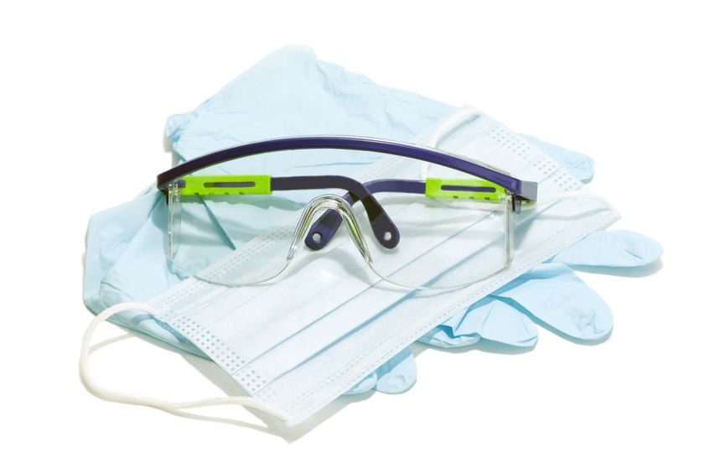
Ad HOC SUPPLY CHAINS in response to the covid-19 crisis
pROF. Dr. Kai Hoberg & Jasmina müller
Online-event OA-Arbeitskreise 2020
September 22, 2020

Slide 2
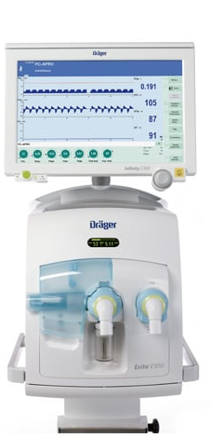
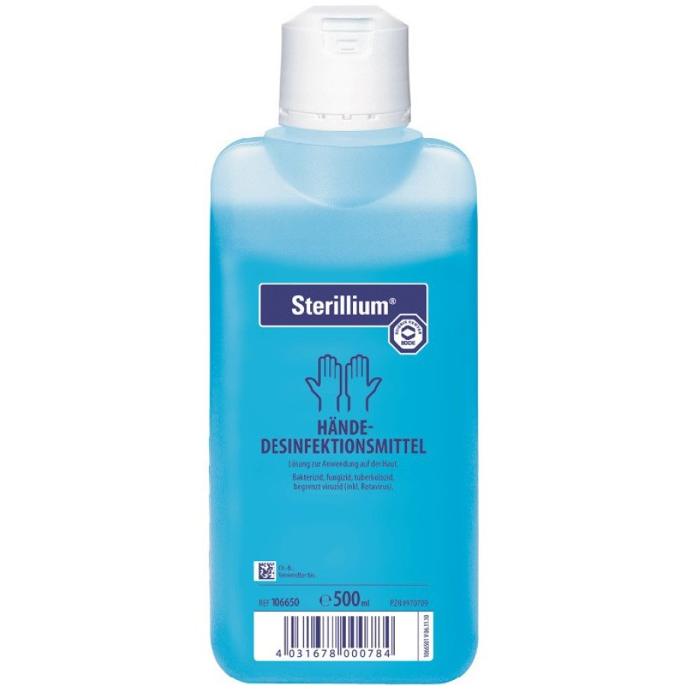
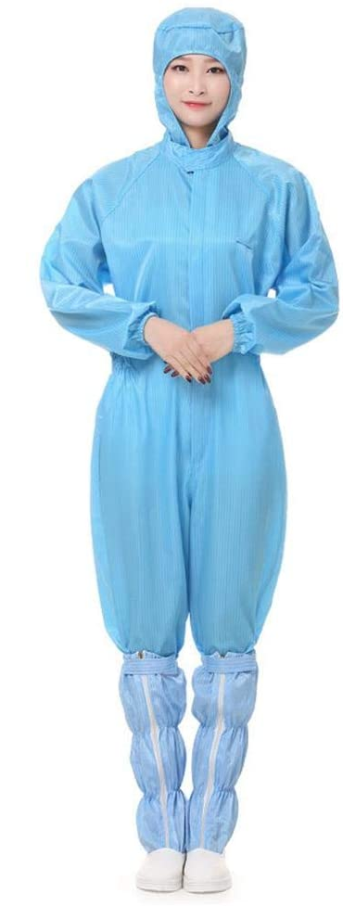
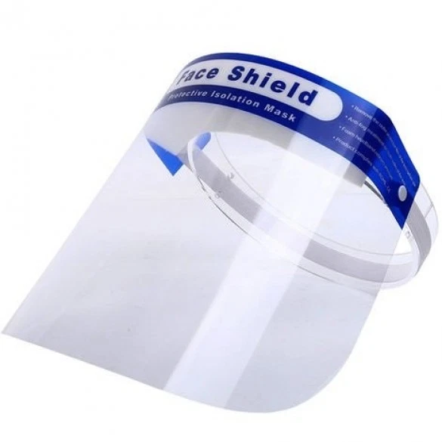
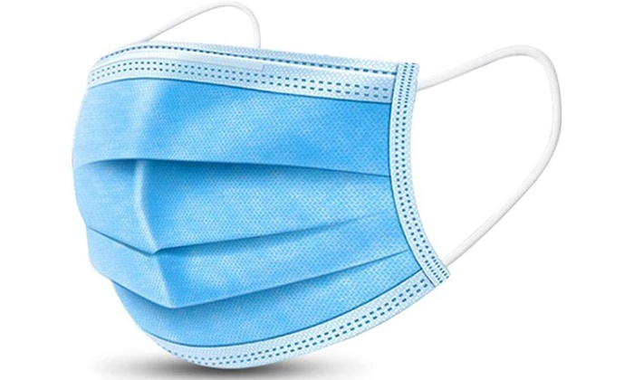
CRITIcAL MEDICAL SUPPLY IN THE COVID-19 crisis
Disinfectants
Personal Protective Equipment
Ventilators
Face masks
Gowns
Face shields

Slide 3

FOR MANY PRODUCTS WE SAW A HUGE INCREASE IN DEMAND WHILE
SUPPLY WAS VERY LIMITED
Supply
Demand
Higher consumption due to higher usage
Panic-buying and speculation
Stockpiling purchases by governmental institutions
…
Limited capacity and full utilization at normal suppliers
Export bans on medical products
Limited transport capacities
…

Slide 4
Key Characteristics of ad hoc supply chains
Response to urgent demand
Demand for PPE, disinfectants and ventilators
increased rapidly
1
2
New product / new market
Production of medical supplies previously not a
core business for manufacturing companies
Local production required due to export bans / lead times
3
Local production
Uncertain development of the situation made it impossible to predict the demand / supply
4
High uncertainty

Slide 5

AS A RESULT OF OWN CAPABILITIES AND ACCESS TO PARTNERS
MANY COMPANIES ESTABLISHED INTERESTING SUPPLY CHAIN OPERATING MODELS
STYLIZED FFP2 SUPPLY CHAINS
Planning
Melt blown Production
Mask
Production
Quality
control
Established
Model
In-house
In-house
In-house
In-house
Orchestrator
Model
In-house
Partner 1
Partner 2
In-house
Collaborator
Model
In-house
Party 2
In-house
In-house
Party 1
Ikea
Model
In-house
In-house
Consumer
In-house
Face mask kits
Emerging
Manufacturer
In-house
Party 1
In-house
In-house
In-house
Typical
challenges
Demand uncertainty
Bottleneck of critical material
Multiple layers of material joined, normally using ultrasonic welding
Certificates and conformity
Supply uncertainty
Long lead times for machinery
Lab capacities fully used

Slide 6
SOME QUOTES FROM 39 INTERVIEWS: SPEED IS KEY
The process from product development to production normally needs at least 6 months. Now, we realized everything in 1-2 weeks.
Head of R&D, medical industry
From Friday to Monday we developed the masks and planned production. On Monday we started the production.
CEO, automotive industry

Slide 7
AD-HOC SUPPLY CHAINS HAVE BEEN DRIVEN BY STRONG COMMITMENTS AND WERE ENABLED BY SPEED
ENABLERS
Designing products to availability of material and assets
Avoiding standard
processes to reduce time to market
Hands-on actions by management and team
CHALLENGES
Limited demand visibility
due to uncertainty
and politics
DRIVERS
Social
responsibility
Ad-hoc
supply chains
Limited material/asset availability due to need
for speed and competition
Business
continuity
Conflicts in teams
due to stress, high workload and challenging situation
Leveraging regional partners and their core competencies
Direct communication within company and public including word-of-mouth

Slide 8


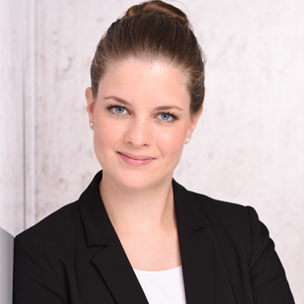
Contact information
Prof. Dr. Kai Hoberg
Full Professor of Supply Chain and Operations Strategy
Head of Logistics Department
Kühne Logistics University
Kai.Hoberg@the-klu.org
Prof. Dr. Jan Fransoo
Professor of Operations Management
and Logistics
Dean of Research
Kühne Logistics University
Jan.Fransoo@the-klu.org
Jasmina Müller
PhD Candidate Operations and Supply Chain Management
Kühne Logistics University
Jasmina.Mueller@the-klu.org

